Slide 1
HITACHI SOLUTIONS INDIA
Plant Disease Detection
Prepared by: Sonali S. Narharshettiwar
Date: 11/06/2020

Slide 2
Agenda
Problem statement​
Dataset structure​
Methodology​
CNN model​
DenseNet
MobileNet
VGG 16
VGG 19
ResNet 50
Algorithm comparison
Demo
References

Slide 3
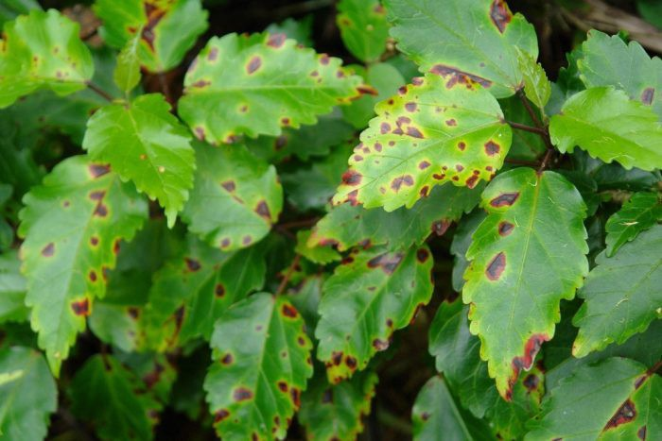
Problem Statement
The rate of plants and crops cultivation is growing rapidly with the increment of human and animal demands all over the world.
During cultivation, farmers faced lots of challenges to protect their plant form different diseases and insects which make their production lower and they faced much financial losses.
To prevent these losses and provide immediate cure, we are using CNN (Convolutional Neural Network) model and other transfer learning algorithms to train the dataset for image processing which will help to identify different types of disease of plant

Slide 4
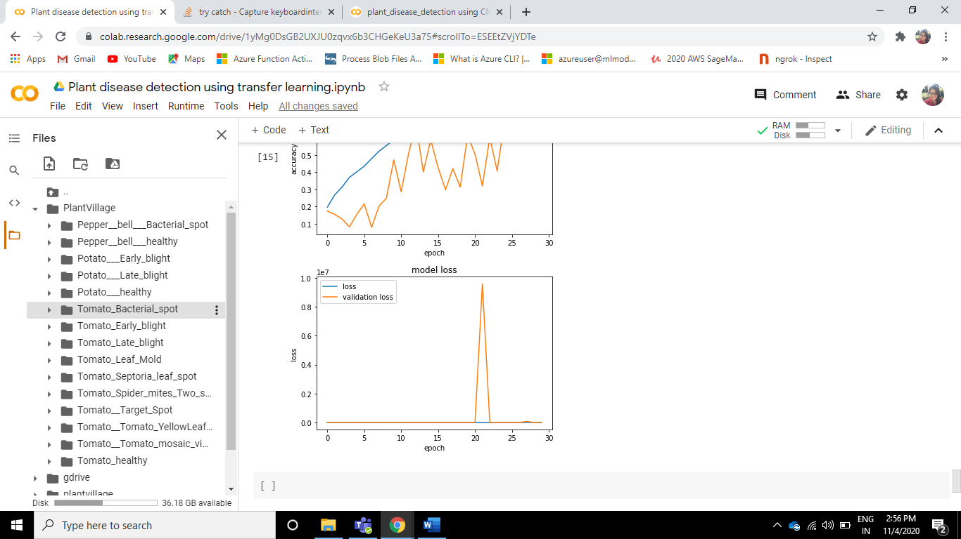
Dataset structure
This dataset consists of 15 different diseases of Bell pepper, Tomato and Potato plant leaves.

Slide 5
Methodology
Step 1 : Load image dataset
Step 2 : Split dataset into train and validation sets
Step 3 : CNN model and transfer learning for training the model
Step 4 : Classify images into 15 different classes
Step 5 : Scoring the model

Slide 6
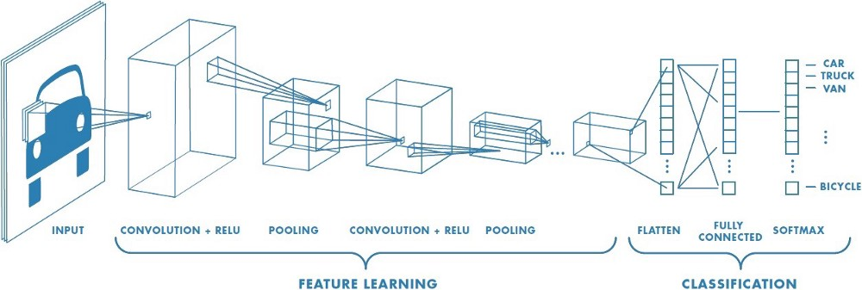
Convolutional neural network
A Convolutional Neural Network (ConvNet/CNN) is a Deep Learning algorithm which can take in an input image, assign importance (learnable weights and biases) to various aspects/objects in the image and be able to differentiate one from the other.
A convolutional neural network (CNN, or ConvNet) is one of the most popular algorithms for deep learning with images and
video.
Like other neural networks, a CNN is composed of an input layer, an output layer, and many hidden layers in between.

Slide 7
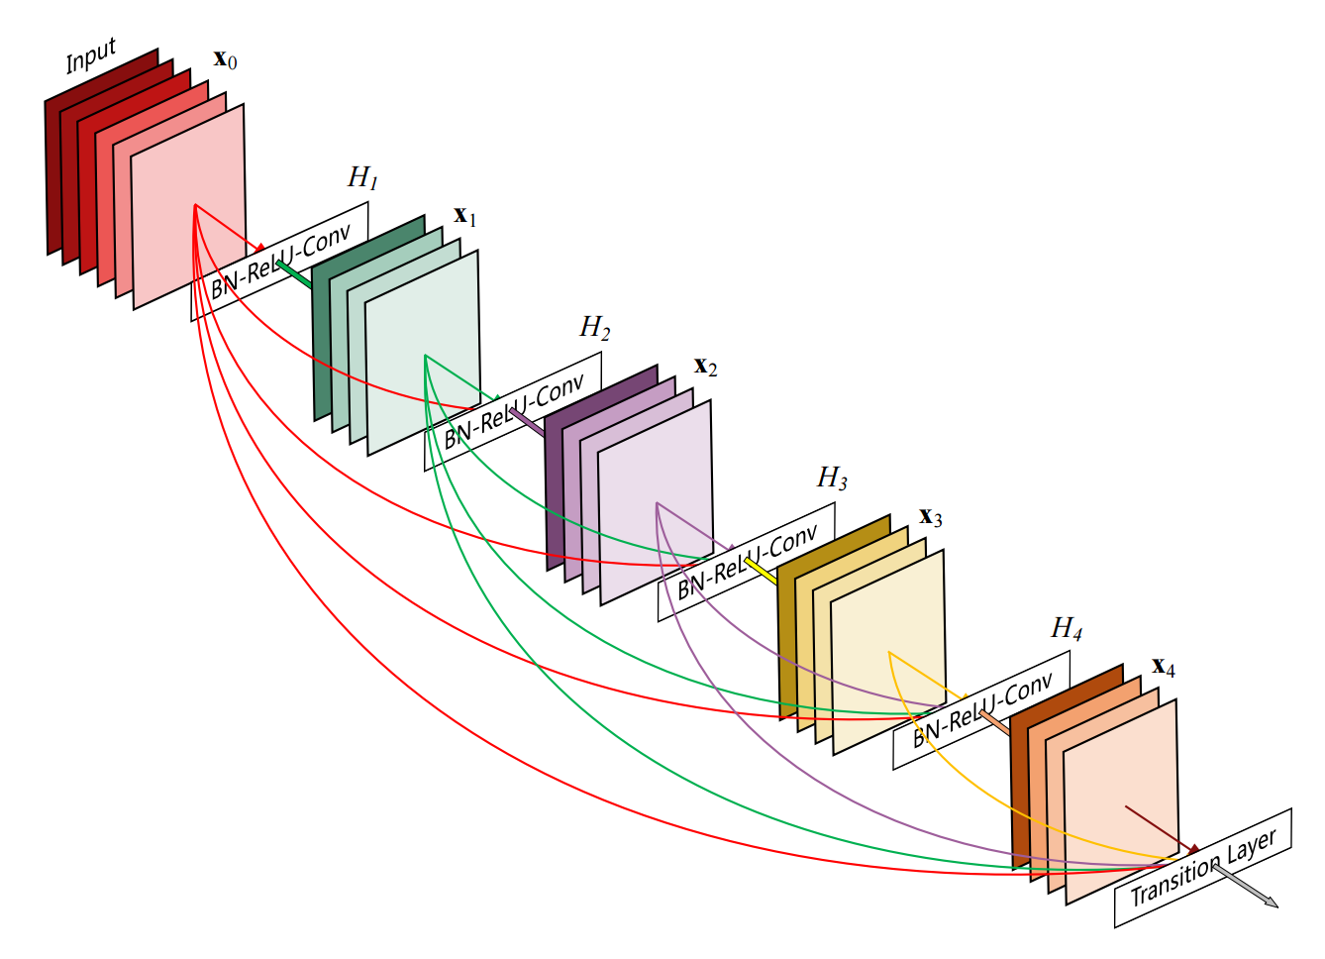
DenseNet
DenseNet is one of the new discoveries in neural networks for visual object recognition.
DenseNet is quite similar to ResNet with some fundamental differences.
ResNet uses an additive method (+) that merges the previous layer (identity) with the future layer, whereas DenseNet concatenates (.) the output of the previous layer with the future layer.
In simpler terms, due to the longer path between the input layer and the output layer, the information vanishes before reaching its destination
DenseNet was developed specifically to improve the declined accuracy caused by the vanishing gradient in high-level neural networks..

Slide 8
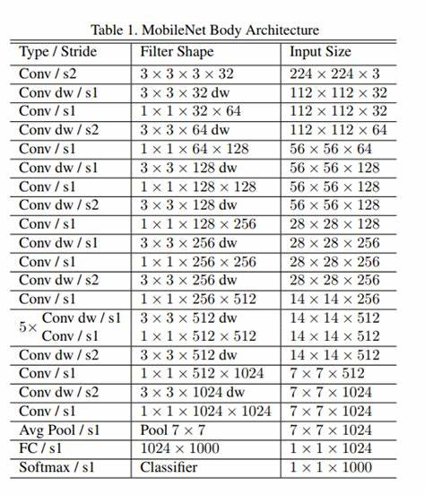
MobileNet
MobileNets are based on a streamlined architecture that uses depth-wise separable convolutions to build light weight deep neural networks.
The effectiveness of MobileNets across a wide range of applications and use cases includes object detection, finegrain classification, face attributes and large scale geo-localization

Slide 9
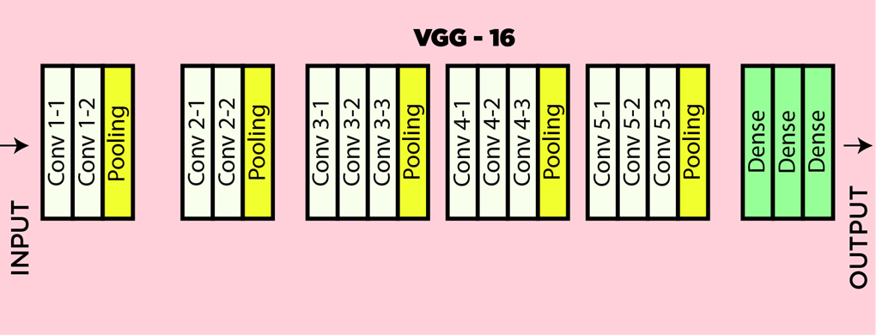
VGG16
VGGNet is invented by VGG (Visual Geometry Group),an academic group (Simonyan and Zisserman) focused on computer vision from University of Oxford.
VGG16 is a convolution neural net (CNN ) architecture which was used to win ILSVR (Imagenet) competition in 2014.
It is considered to be one of the excellent vision model architecture till date

Slide 10
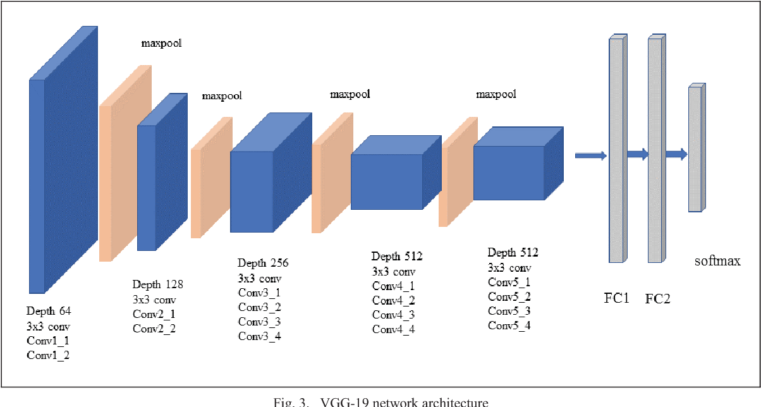
VGG19
VGG19 is a similar model architecure as VGG16 with three additional convolutional layers, it consists of a total of 16 Convolution layers and 3 dense layers.
Following is the architecture of VGG19 model. In VGG networks, the use of 3 x 3 convolutions with stride 1 gives an effective receptive filed equivalent to 7 * 7.

Slide 11
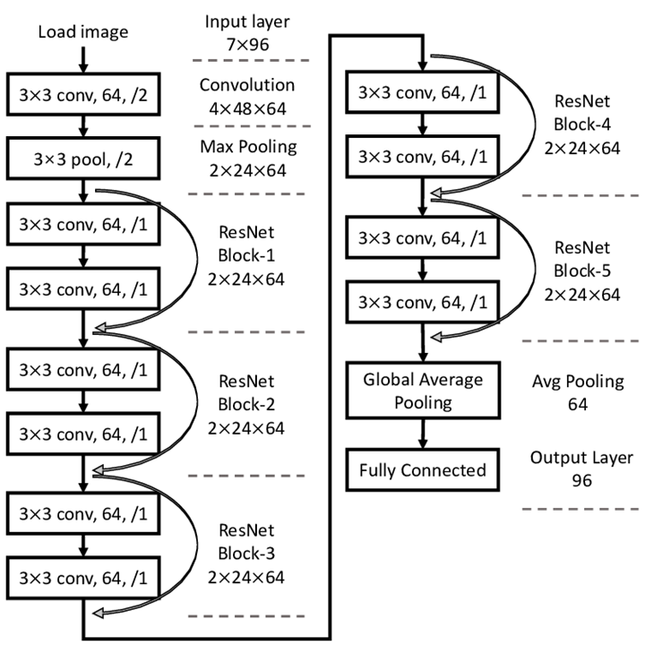
ResNet 50
ResNet architecture is a combination of Residual Blocks so you can stack more blocks to make it deeper.
ResNet50 is a variant of ResNet model which has 48 Convolution layers along with 1 MaxPool and 1 Average Pool layer.
Skip connections are shortcut connections which skip few convolutional layers to resolve vanishing gradient problem.

Slide 12
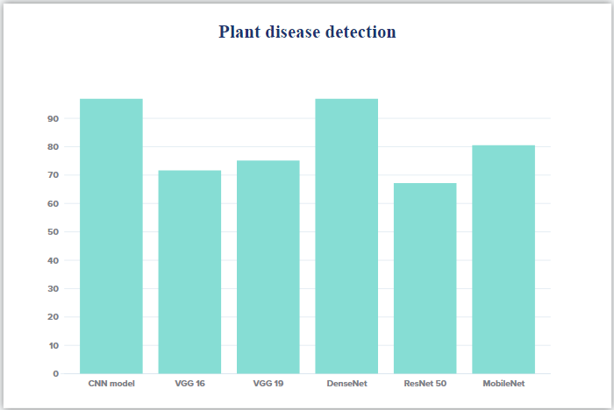
Comparison of Validation Accuracy for different Architecture
96.92%
96.88%
80.54%
75.16%
71.68%
67.15%

Slide 13


Slide 14
References
https://www.ijert.org/plant-disease-detection-using-cnn-model-and-image-processing
https://towardsdatascience.com/plant-ai-plant-disease-detection-using-convolutional-neural-network-9b58a96f2289
https://www.pluralsight.com/guides/introduction-to-densenet-with-tensorflow

Slide 15
Thank You!!

